Slide 1

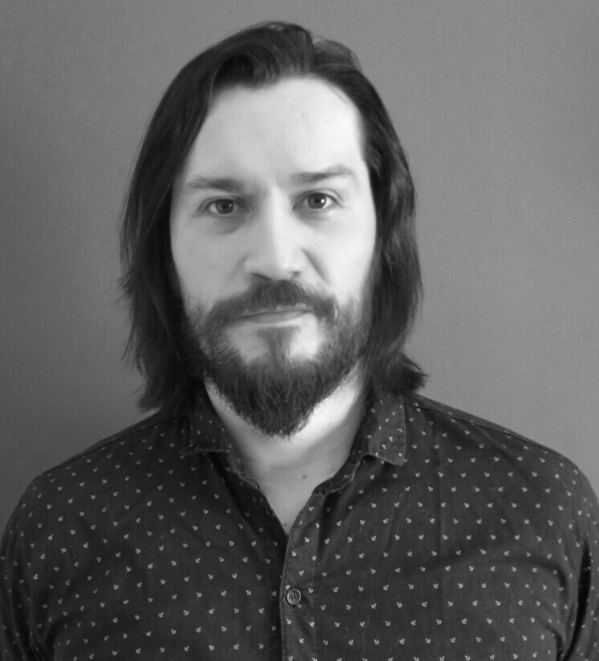

Federico A. Tobares Garcia
SELECTED EXPERIENCE
Data Engineering Specialist
Technology / Data & AI
f.tobares.garcia@accenture.com
Buenos Aires, Argentina
Technical Lead @ Accenture, ARG
Role Title: Technical Lead
Project: BBVA
Blue Prism
Sr. Developer @ Accenture, ARG
Role Title: Sr. Developer
Project: Grupo Petersen
Blue Prism
Semi Sr. Developer @ Accenture, ARG
Role Title: Jr. Developer
Projects: Prisma Medios de Pagos
Blue Prism
I have approximately six years of experience at Accenture, working on process automation and digital transformation initiatives, mainly within the financial services and banking industry. I have held roles as Team Lead and Technical Lead for Blue Prism automations, leading delivery teams, defining technical solutions, and ensuring quality, governance, and operational excellence.
Throughout my career, I have contributed to the automation and optimization of administrative and financial processes, collaborating closely with business and operational stakeholders. Currently, as a Team / Lead Specialist, I combine leadership, process analysis, and technical expertise to drive efficiency, scalability, and continuous improvement in complex enterprise environments.
PROFESSIONAL BACKGROUND
AREA OF EXPERTISE
HARD/SOFT SKILLS & TOOLS
Dev: Blue Prism
DB: Oracle/SQLServer/MySQL
RPA: : Blue Prism Specialist
RPA: Blue Prism Architecture
Cloud : GCP / VertexAI /Conversational Agents / Cloud Storage / Cloud Run
AI: Gemini, Copilot, Anthropic
Other: Phyton, C#, .NET
EDUCATION
Diseño de 3D Envoriments (DaVinci)
Licenciatura en Sistemas – 2do año (DaVinci)
LANGUAGES
English (A1)
Spanish (Native)
INDUSTRY
Banking – Go
Finance
Accenture
4

